Slide 1
The Mirecki Factor
A TLC Presentation
By
Kelsey Hayes, Lauren Bruning & Chris Hickerson

Slide 2
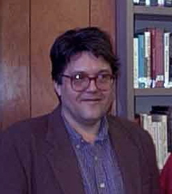
Background Information
Dr. Paul Mirecki was Chairman of the Religious Studies Department.
Dr. Mirecki wanted to teach a class entitled “Creationism, Intelligent Design and Other Religious Mythologies” for the Spring 2006 Semester.

Slide 3
Background Information
The course was met with some controversy, but overall was accepted by the university community.
The general controversy surrounding the course was that intelligent design was taught in a religious context and not in a scientific context, as is the wish of some members of the Kansas legislature.

Slide 4
Dr. Mirecki’s Comments
The issue remained stable until a comment made by Dr. Mirecki on a list server for the Society of Open-Minded Atheists and Agnostics was brought out into the open.
Mirecki said that “The fundies want it all taught in a science class, but this will be a nice slap in their big fat face by teaching it as a religious studies class under the category ‘mythology.’”

Slide 5
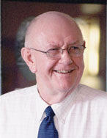
Administrative Reaction
Chancellor Hemenway called Mirecki’s words “vile.”
Chancellor Hemenway attended a TLC class to speak with us about our opinion on the matter.
The administration took no immediate disciplinary action against Mirecki.

Slide 6
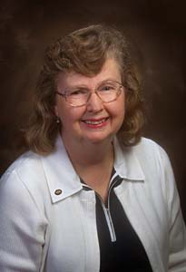
Legislative Reaction
Senator Kay O’Connor (R-Olathe) was one of Mirecki’s biggest critics after the comment came out.
O’Connor said, “I’m very disappointed that this professor seems to think he can use taxpayers’ dollars to teach a class that will poke a stick in the eye of conservative Christians out there.”

Slide 7
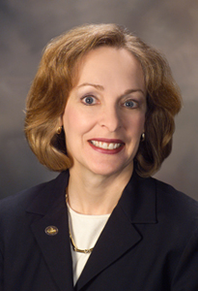
Legislative Reaction
Senator Karin Brownlee (R-Olathe) met with Chancellor Hemenway to discuss the class and to voice her concern that Mirecki had been disrespectful of Christians.

Slide 8
Legislative Reaction
Rep. Bob Bethell (R-Alden) said, “I don’t think that the legislature should really be in the position of managing of what the course work is,” he said. “However, I think that any course work should be determined on the basis of teaching people how to think, not what to think.”
Senator Karin Brownlee (R-Olathe) said, “My goal was not to see him resign or anything like that. My goal was to assure that, should the course be taught, it be taught will all perspectives fairly represented in the classroom.”

Slide 9
Funding Repercussions
Members of the Kansas Legislature have hinted that they might begin to cut university funding in retaliation for Mirecki’s comments.
It is also speculated that other faculty members and departments may be singled out or watched for other subversive comments and actions that may not fit with the legislature’s opinion of what should be taught at KU.
Kay O’Connor, Karin Brownlee and Brenda Landwehr are three legislators who have hinted at such.

Slide 10
Other Repercussions
Dr. Mirecki dropped the word “mythologies” from the course title.
The course was removed from the catalogue for the Spring 2006 semester, but it might be taught later (revised).
Dr. Mirecki was the victim of a physical assault.
Dr. Mirecki resigned as chair of the Religious Studies department.

Slide 11
Arguments For & Against Cutting Funding
Dr. Mirecki’s comments could be construed as “hateful” and specifically targeted at Christians.
The legislature does in fact have authority over funding, and if something is done to displease them, they are within bounds to cut it.
It is not fair to punish an entire institution for the actions of one professor.
Dr. Mirecki was exercising his freedom of speech and should not be punished for it.

Slide 12
Conclusive Opinion
The funding for KU should not be reduced solely on the basis of Dr. Mirecki’s actions.
However, Dr. Mirecki had not considered the repercussions of his exercise of free speech, and should have been more sensitive to the mood and opinions of the legislature.
It is not necessary to in effect “spy” on other departments for similar behavior.
We must be prepared to address this issue in front of the legislature, and defend our position on it.

Slide 13
Sources
Katie Lohrenz. “Professor resigns after controversial class cancelled.” The University Daily Kansan. Dec. 8, 2005.
Frank Tankard. “Intelligent Design class stirs up storm.” The University Daily Kansan. Nov. 30, 2005.
University of Kansas website. www.ku.edu.

