Slide 1
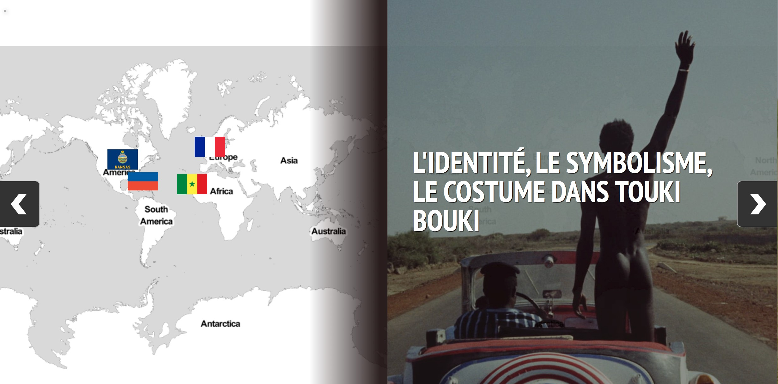
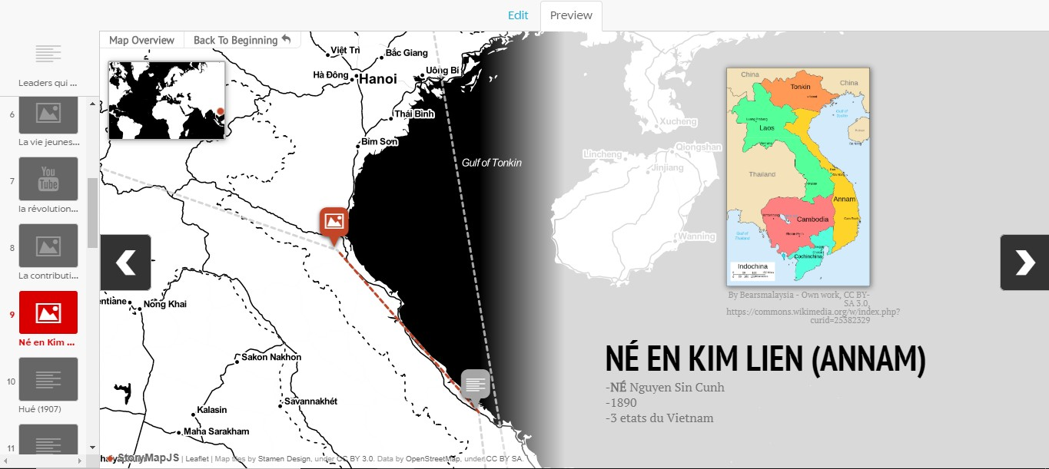
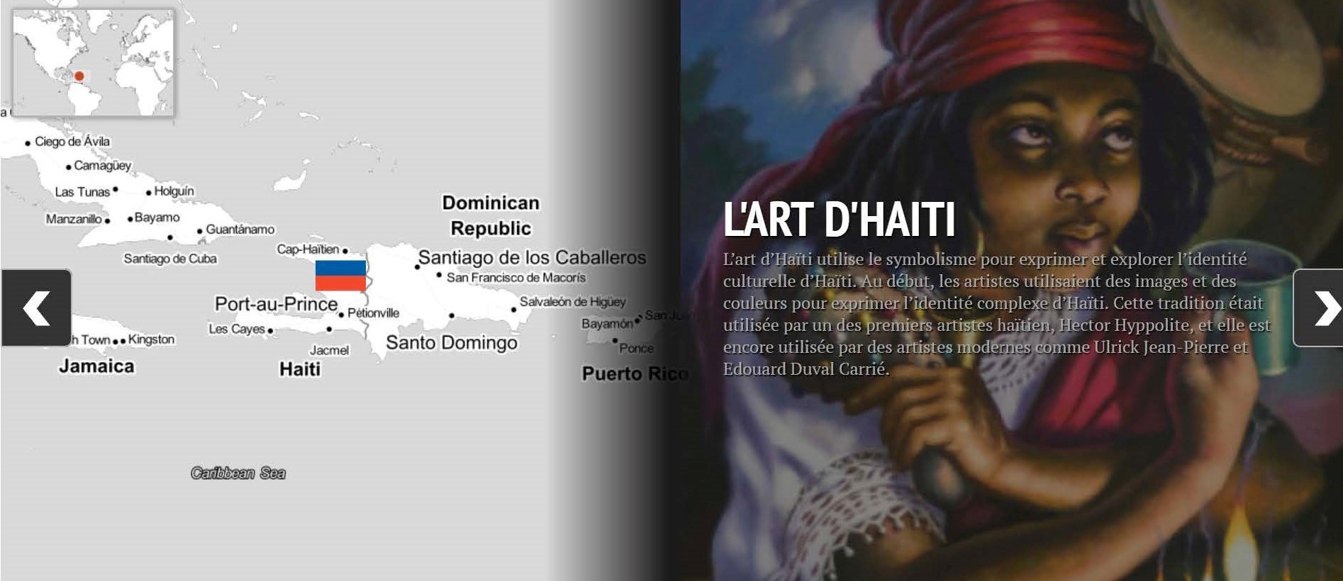
Building a Doorway to the French-speaking World
through StoryMaps
Antje Ziethen, French, Francophone & Italian Studies
Course Background
FREN 431 The French-Speaking World introduces students to the French- speaking world with particular emphasis on the Americas, the Caribbean, Africa, and the Indian Ocean. We study a variety of materials (fictional and non- fictional texts, art, comics, film, music, documentaries) to get insights into the historical, linguistic, and societal specificities of each region. Moreover, students have the opportunity to exchange with visiting speakers from Francophone regions. The course is taught in French and includes out-of-class activities.
Students: Upper-level undergraduate students (minors and majors) in the Department of French, Francophone & Italian.
Prerequisites: FREN 301 (French Grammar) and FREN 326 (French Literature).
Student Work
High engagement with topics, with most students exceeding requirements
Creative & original work
Individual and collective
reflection on topics
Class cohesion due to group work
Project by Alex Cateforis on the Senegalese movie “Touki Bouki”
Alex participated in extracurricular activities to do research, including:
Attending the “Unexpected Caribbean” Symposium at KU
Going to a film screening of a Senegalese movie organized by the Department of African and African American Studies
Interviewing Mamadou Dia, a Senegalese filmmaker who was the inaugural Hall Center Interdisciplinary Scholar in Fall 2018.
The Challenge
I taught FREN 431 once before in Fall 2016. As part of the course work, students had to give a conventional presentation, but the results were disappointing. Analysis of the material remained in general very superficial.
Students were very interested in the course material as such, participation was strong, and class discussions meaningful, but I was not able to harvest their enthusiasm for this particular project. In order for my students to get more involved, I will have to do the same – in the form of regular meetings and feedback.
Addressing the Challenge
For Fall 2018, I completely restructured the assignment and gave it more weight in the overall course. The changes had the following objectives:
Project by Claire Wakefield on Haitian paintings
Claire participated in extracurricular activities beyond project requirements to do research, including:
Attending KU’s “Unexpected Caribbean” Symposium
Visiting the exhibition “Ties that Bind: Haiti, the United States and the Art of Ulrick Jean-Pierre” at the Spencer Museum of Art.
While the project itself was well done, StoryMap was not the best platform for it due to the limited geographic scope (Haiti) and small text size.
Project by Tom deZutter on political figure Ho Chi Minh of Vietnam
Tom did archival research and read more sources than were required, even finding original letters online.
He was able to use StoryMaps to follow Ho Chi Minh’s many movements between Vietnam, France, China, the US, UK, and the Soviet Union.
For this particular project, StoryMaps worked really well, as the other students noted.
Fostering teamwork and cross-cultural analysis. Students worked in groups of 2-3, each concentrating on a different francophone region but under one umbrella subject. In the end, they had to present a comparison between the regions to the class.
Increasing students’ digital literacy in an academic setting. Students worked creatively with the tool StoryMap which had been successfully tested by a colleague in Spring 2018.
Helping students acquire research skills, specialized knowledge, and critical thinking. The final assignment was scaffolded by seven steps, including consultation with a librarian, a StoryMap training session, progress reports, a presentation, and evaluation.
Providing feedback and support. Time was given in class for group work and meetings with the instructor at different project stages.
Appropriate assessment. Creation of a rubric provided students with a guide for what was expected of them and a way to assess them on the objectives of the project.
Lessons for the Future
Student Feedback on StoryMap Project
QUESTION | YES | NO
How do you evaluate your group work? Did everyone do their share? | 4 - Collective learning experience, exchange, sense of community | 2 - Some team members worked more than others
Was StoryMaps a good tool? Why or why not? | 3 - StoryMap was a good tool; would use it again | 3 - Prefer Powerpoint or Prezi over StoryMap
What are your thoughts regarding the scaffolding of the assignment? Did you have enough time for each of the steps? | 5 - Scaffolding allowed for better preparation and outcomes | 1 - Scaffolding does not correspond with students’ work habits
Was there sufficient feedback and support? | 6 - Both peer and instructor feedback were helpful | 0
Make group work optional
Make use of StoryMaps optional; allow PowerPoint, Prezi, or other tools, which may be better suited to students’ individual topics.
Revise due dates for the different steps of the assignment; some steps had more time than necessary, while others did not have enough
Revise instructions for some of the assignment steps
Revise rubric to better assess presentation; rubric was too detailed and did not give enough weight to foreign language aspect
This work was funded by the 2018 Best Practices Institute

