Slide 1


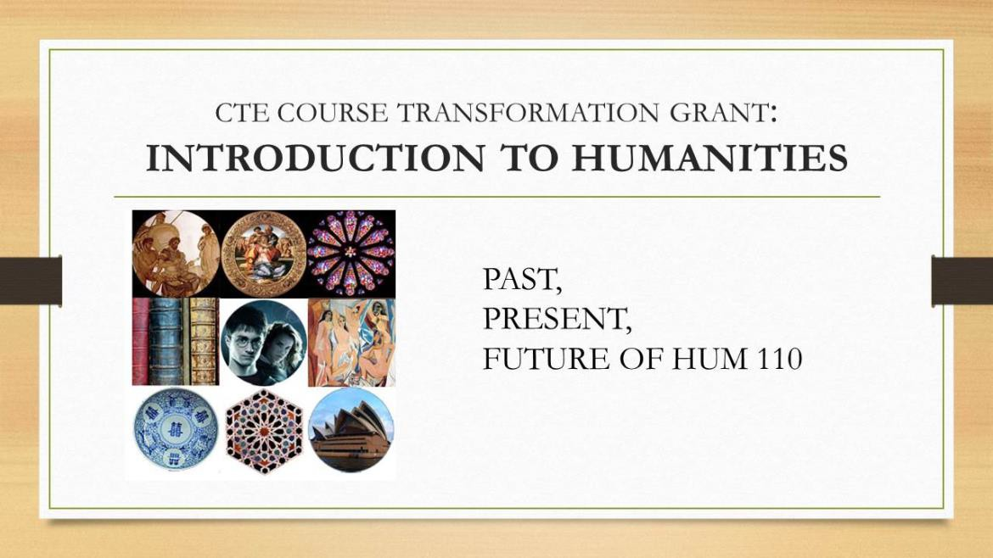









Redesigning Introduction to Humanities
Aimee Wilson, Dale Urie, and Antha Cotten-Spreckelmeyer—Humanities Program
Background
HUM 110 Planning Workshop and Redesign
HUM 110 (Introduction to Humanities), the gateway course for the Humanities Program, explores the question “What does it mean to be human?” as a way of introducing students to the humanities through various themes.
In Spring 2019, we hosted a workshop to bring Humanities faculty together to discuss the past, present, and future of HUM 110. We discussed proposed revisions to the curriculum guidelines, updated the course themes, and brainstormed ways to apply humanities skills to the workplace.
HUM 110 fulfills requirement 2.1 (Written Communication) of the KU Core and enrolls mostly freshman and sophomore non-majors. The diverse backgrounds of these students is an asset to the course and creates an environment in which students can learn from one another.
Humanities in the Workplace
Future iterations of HUM 110 will include a unit (or its equivalent over the semester) on the value of skills covered in HUM 110 to various workplaces. This unit may include readings, in-class activities, or assignments.
Redesign Goals
Courses will also include an assignment that makes connections outside the classroom (writing contests, internships, grants, etc.)
Take greater advantage of existing student interest in the course by:
Updating course themes and curriculum guidelines
Making clear to students that the course provides instruction in practical, transferrable skill sets (e.g., critical thinking, moral reasoning, articulating ideas, appreciating diversity, evaluating evidence, etc.)
Helping students see the relevance of HUM 110 by engaging them in opportunities outside the classroom
Revise course description to accurately represent the teaching being done in this course
Proposed Updated Course Themes
What does it mean to be human? Courses focus on 1-4 of the following themes:
Next Steps
One-on-one conversations with current HUM 110 instructors to collect readings, multi-media texts, and assignments that work well in current courses
Justice
Spirituality and Faith
Planning
Technology
Sex and Love
(In)tolerance
Creation of a “menu” of teaching units – one for each course theme – based on the materials provided by instructors
To plan the redesign of HUM 110, we:
Held a faculty workshop to gauge instructor goals and solicit feedback on a proposed revision of curriculum guidelines
Created a database of funding and award opportunities appropriate for HUM 110 students
Created a database of articles attesting to the value of the skills learned in HUM 110 in various workplace settings
The Body
Play and Creativity
Ecology
Administer surveys to gauge student understanding and engagement with current HUM 110 courses, to be repeated after the course redesign
Continue working on the revised course description
This work was supported by a C21 Course Transformation Grant. We are grateful for the help of Michael Otteson, who assembled the databases and assisted with the workshop. All Humanities Program faculty contributed insights and experiences to this project.

