Slide 1
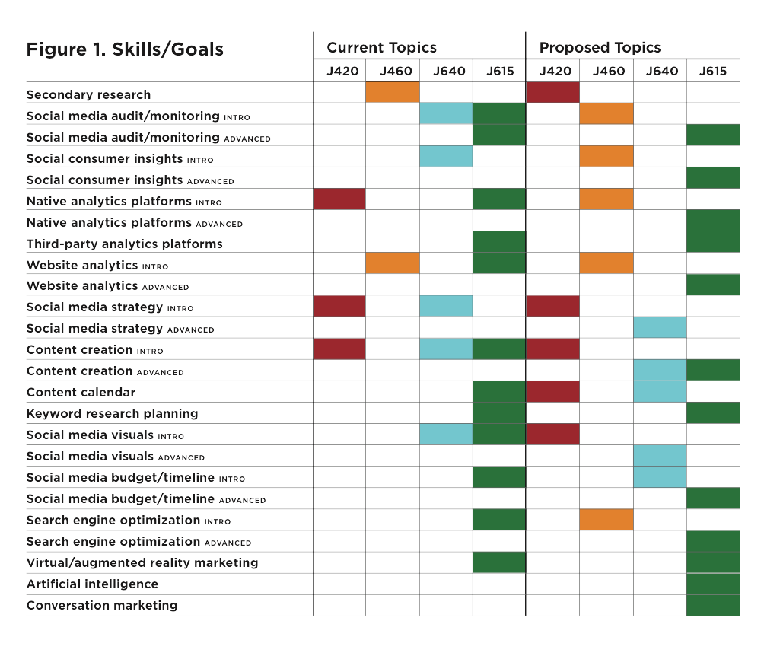









Transforming Social Media Curriculum: Data Hub for Evidence-based Teaching
Hyejin Bang, Yvonnes Chen, Joseph Erba & Hyunjin Seo—School of Journalism and Mass Communications
Background
⌘ The School’s curriculum was no longer ideally positioned to prepare students for careers in the digital media environment
TRANSFORMATION PLAN
Summary of Key Activities
Facilitating regular team meetings and lunch sessions with faculty for reflections, discussions and updates
1. Transform Upper-level Courses
2. Build a Social Media Data Hub
J420 (Strategic Comm II) : alternate posting content on Facebook, Twitter and Instagram pages associated with the hub as part of their social media content creation assignment
J460 (Research Methods): use the hub for social media analytics assignments examining engagement types and audience behaviors through native analytics platforms
J615 (Social Media): contribute advanced-level content to the hub such as augmented reality content
J640 (Capstone): utilize the hub to test messages and tactics before finalizing
them for client presentations
Visiting MIT, Boston University and Northeastern University in Nov. 2018
⌘ Inconsistency was common across different sections of the same course and was coupled with a lack of coordination across courses
Reviewing online certificate programs at KU and other universities to assist in the coordination of online and offline resources to enhance student learning experiences
⌘ Urgency for this project was added with the School being in the midst of building and classroom renovations intended to enhance student- centered, hands-on learning
Refining the curriculum innovation roadmap and bringing in industry speakers to discuss digital and emerging media skills
Overall Goals
⌘ Achieve student-centered learning and evidence-based teaching in social media and emerging technologies
Working with two research assistants on various aspects of the project
Sustainability Plan
3. Enhance Real-World Experience Through Service Learning
J420: develop a mini social media plan for an organization working to improve lives of underserved populations
J460: conduct research needed for the social media plan J420 students will create
J615: actually manage social media accounts and implement social media campaigns for nonprofit organizations working with underserved populations
J640: develop comprehensive campaigns for local organizations as project teams
Student-generated content resulting in refreshing learning materials with new groups of students joining the hub and class activities being updated to reflect recent changes
⌘ Enable students to get involved in experiential activities throughout the curriculum by transforming four core strategic communication courses
4. Develop Coordinated Hands-on Exercises
Utilizing the social media hub, instructors work together to produce sequenced assignments for hands-on learning of social media auditing, metrics, etc.
The data hub to be centrally housed on the web portal of the Center for Digital Inclusion, which is located in the School and led by the project lead
5. Streamline Assessment of Student Learning for Evidence-Based Teaching Assessment includes focus groups and online surveys, comparative study of social media usage, clear educational goals, student feedback on major assignments, practice opportunities for students through the social media hub, and iterative evaluation based on empirical data.
⌘ Influence the learning and teaching culture throughout the School by encouraging more informal course transformations through goal- oriented curriculum discussions and collaboration among instructors
Make manuals for using the hub available on the web portal
6. Create Online Modules for Project-Based Curriculum
Students learn key concepts and skills through online modules and use certain regular class times for smaller-group, hands-on lab exercises related to their projects
Make links to these resources and relevant documents available on Blackboard open to the School’s faculty
This project was part of the 2018-19 Curriculum Innovation Program, supported through funds provided by Bob & Kathie Taylor

