Slide 1
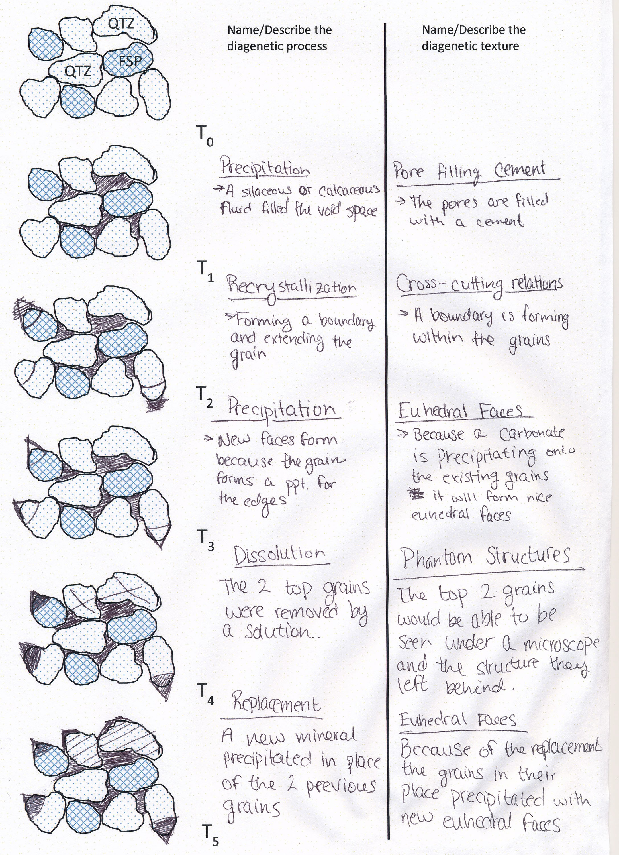
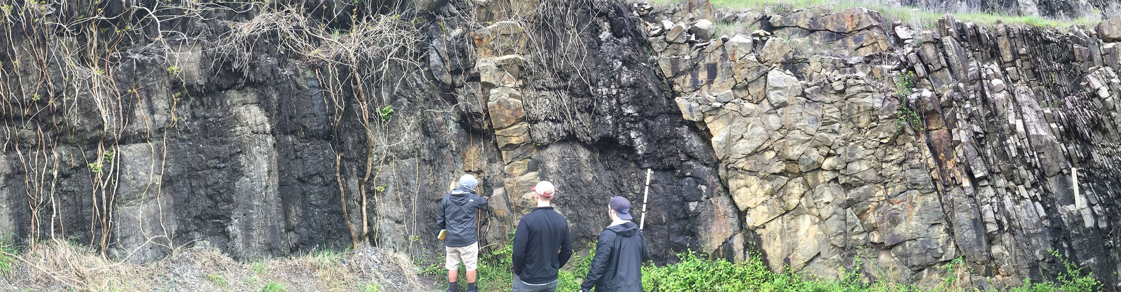
Transforming 1st Year through 4th Year Courses—Geology Course Innovations
D. Kamola (GEOL 331), A. Möller (GEOL 101, 512), N. McLean, J.A. Roberts (GEOL 101), A. Olcott (GEOL 121)
Department of Geology
Intro Level: GEOL 101 & 121
Upper Level Class Transformation Examples
Two large introductory level geology classes have been successfully transformed from traditional lecture to active learning, and progress has been monitored over 10 years, yielding important results on minority and general student retention rates and performance. The results were published last year.
GEOL 331: Sedimentology & Stratigraphy
Classroom observation results for transformed GEOL 331. Activities show high percentages of working and guiding, indicative of active learning.
0 20 40 60 80
Receiving Talking to Working Presenting Guiding Admin
72
31
Student Activities
Roberts, JA, Olcott, AN, McLean, NM, Baker, GS, Möller, A. (2018) Demonstrating the impact of classroom transformation on the inequality in DFW rates (“D” or “F” grade or withdraw) for first-time freshmen, females, and underrepresented minorities through a decadal study of introductory geology courses. Journal of Geoscience Education, 66, 304-318.
44
62
72
Instructor Activities
3
Geology is an applied science requiring a high level of analytical thinking and interpretation, including formulating the questions that need to be answered.
Development of critical thought is essential for the students to be successful professionals.
Upper level classes are transformed to increase student performance in higher level Bloom's activities.
Source: elearningindustry.ocm
Transformed exercise. Students describe diagenetic process and texture of sediment through time.
Students evaluate sedimentary structures in an outcrop in northwest Arkansas. Groups collect data and create class presentations to discuss their analysis.
Upper Level Course Transformations: GEOL 331 & 512
GEOL 512: Igneous & Metamorphic Petrology
A new exam question requiring application and analysis was added in 2014. The task was discussed in detail during class. However, the results were poor; the score was 21% lower than the average exam. Additional practice and discussions were incorporated in 2015 and 2018, with each step improving course grades.
%-Difference Question Score vs. Exam Score
Geology 331, Sedimentology and Stratigraphy, covers the principles used in the study of sedimentary rocks and striatal successions. Physical, chemical, and biological processes in sedimentary environments are applied to the recognition of the depositional facies.
Preservation of these environments and alteration of sediments and sedimentary rocks after
burial is also covered. In addition to laboratory sessions, students test their interpretation skills on field trips. Geology 331 is a sophomore level course and averages 25 students.
10
5
0
-5
-10
-15
-20
%
2 | 01 | 4 2015-2017 2018-2019
Geology 512, Igneous and Metamorphic Petrology, studies the processes that form minerals and rocks within Earth's crust and mantle. Students learn about plate tectonic processes influencing volcanism and mountain ranges. The course uses concepts of chemical equilibrium thermodynamics, magma crystallization, quantitative analysis of mineral assemblages and geochemical analyses. This senior level course averages 15 students.
Transformations in GEOL 331:
Discussing learning objectives
Reinforcing class materials with laboratory materials and field trip activities
Active learning (e.g. pre-class readings and group discussions)
Transformations in GEOL 512:
Hands-on training of student skills to increase problem solving skills needed in the course
Problems given as homework before being covered in tests
More opportunity for student practice and feedback
Correct and complete problem set solutions discussed in class
Other current transformation efforts center on incrementally scaffolding the capstone activity of the class, an individual topic, research style term paper. Results will not be available until finals week.
Observations to Date
Improvement in GEOL 512 exam score post-transformation:
2014: New question added to exams; students perform poorly.
2015-2017: Example homework, returned with feedback.
Solution discussed in class. Score 4% higher than exam average.
2018-2019: Solution posted online after peer-to-peer
classroom discussion. Score improves to 8% above exam average.
Students in both upper level classes now have a better understanding by working through the processes presented in the course. This is likely due to moving the course focus to requiring students to apply processes as opposed to just explaining them and relying on memorization.
This project was part of the 2018-19 Curriculum Innovation Program, supported through funds provided by Bob & Kathie Taylor

