Slide 1







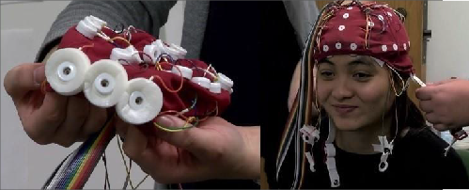
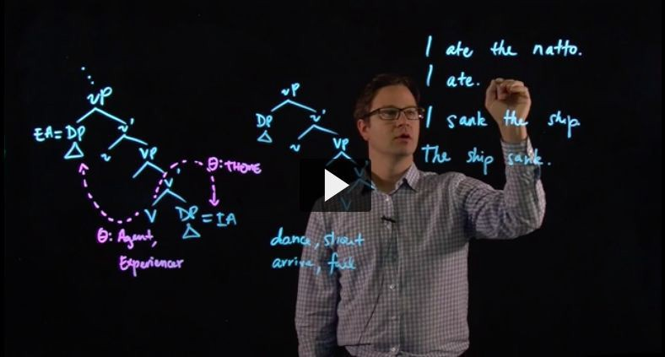

Creating a More Interactive Undergraduate Linguistics Curriculum
Philip T. Duncan, Caitlin Coughlin, John Gluckman, Robert Fiorentino, & Andrew McKenzie | Linguistics Department
Current challenges
Solutions
Implementation
Linguistics is an exciting discipline to introduce to
undergraduates because language permeates so much of human experience. Understanding the intricacies of language requires a unique level of abstraction, which students are
not used to adopting when they think about language.
For this project, we selected three core undergraduate courses— LING 106: Introductory Linguistics, LING 438:
Neurolinguistics I, and LING 325: Syntax I—where abstract theoretical concepts make it more challenging to engage students. By modifying, expanding, and restructuring these
courses, we sought to provide more active and collaborative learning experiences built on better scaﬀolding and process-driven content.
① Ling 106 - Introductory Linguistics
Implement active learning in discussion sections
Scaﬀold capstone assignment
② Ling 438 - Neurolinguistics I
New materials & hands-on activities to illustrate
brain-imaging methods, stimulate research
New learning opportunities through online video content
③ Ling 325 - Syntax I
Reworked, flipped lecture: Emphasize the scientific method
through engaging data, leading into lecture
New online videos reinforce/exemplify core concepts
Our course transformations:
Student-centered instruction & design
Active learning with hands-on engaging content
Process-oriented discovery
The Curriculum Innovation Program grant enabled us to partner undergraduate & graduate students, who were hired as Curriculum Innovation Specialists. These students were responsible for:
Curating new content
Developing learning modules & lesson plans
Claire Schumacher
Owen Brown
Avery Mojica
Hyunkyoung Eoh
Haley Schippers
Xiao Yang
Reflections
Course transformations
Reﬂections
Linguistics has been able to successfully transform 3 classes that form the core of our curriculum. By focusing on linguistic inquiry as a process and making these courses a space for active learning, our instruction now leans less on traditional lecture, and more on interactive, hands-on exercises that increase student engagement, encourage collaboration and interaction, and make abstract concepts more approachable.
New in-class materials allow for demonstration instead of “talking at students,” and new online supplements provide additional opportunities to interact with technological
resources and oﬀer extra support for key concepts and skills.
Partnering with students enabled our success by
increasing ideas, resources, and allowing faculty to focus on broader structure.
1
Create new, engaging content
Scaﬀold capstone assignment
Reduce amount of lecture during discussion sections
Increase collaborative work
Provide interaction with
multimedia content to explore the process of linguistic inquiry
Language activities for capstone assignment integrated throughout the course
In-class exercises & conversations explore diverse
grammatical features and invite application of linguistic theory
Make processes explicit & demonstrate skills using diverse languages as examples
2
Develop new activities
Introduce hybrid content
3
Leading into lecture
Online supplements
Activities introduce research process, provide engagement with brain-imaging techniques
Research development modeled
Datasets curated to raise
specific theoretical questions
Students discover insights further expounded in lecture
We are especially grateful to Nathan Schellenberg (a master’s student who assisted with developing new content for LING 106), and the supportive faculty in the Linguistics Department.
This project was part of the 2018-19 Curriculum Innovation Program, supported through funds provided by Bob & Kathie Taylor

